Slide 1

宁波安劢机械有限公司
宁波保税区安得国际经贸有限公司
NINGBO AND MACHINERY CO.,LTD
NFTZ AND INTERNATIONAL INDUSTRY&TRADE CO.,LTD

Slide 2

Brief
, is a bridge connects China to the world .
Ningbo AND Machinery, is professional with mechanical power transmission parts , engineering&supply bearings, shafts, gears and machining parts of various machinery .
Our parts work in not only the traditional common areas such as construction machinery, mining machinery, agricultural machinery, food machinery and household appliances, machine tools and all other equipments of industry process , but also exist in new energy power generation, E-Bike , Electric vehicle ,etc…….
We have established firm cooperative relationship with clients all over the world in the past 20 years , built good reputation depends on our professional technical ability and perfect service.
We are unsung heroes, supporting machines running in every corner of the world.
Drop me an opportunity to be a trusted partner to you !

Slide 3
Bearings: Right design and installation helps to reliably meet the expected functions of the entire equipment, such as high precision, low noise, acceptable temperature, long life and so on.
Shafts: High-precision shafts together with bearings form the basis of a perfect transmission system in every machinery .
Gears: In many mechanical transmission systems, as well as hydraulic oil pumps, high-precision, low-noise, long-life gears are still essential parts.
We are able to support our customers to develop and improve the products , professionally and experienced suggest or discuss with customers about properly designing bearings and shafts they want , manufacturing technology …….our team will control quality strictly and improve constantly while the order placed , so as to provide customers with the proper , reliable and competitive products .
Our advantage is , consolidated design and supply bearing+shaft+gear+machining parts .
Our products have been widely used in a wide variety of machinery and vehicles, such as E-bus, E-Bike, UTV, Machine Tool, Reducer, Electric Motor, printing machinery, food machinery, garden machinery, construction machinery, Household appliances……

Slide 4
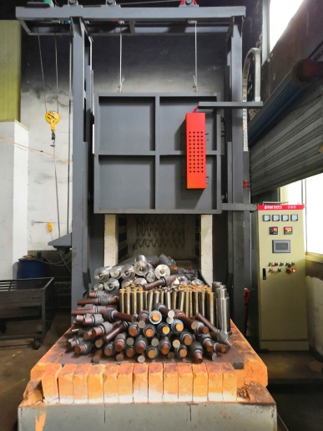
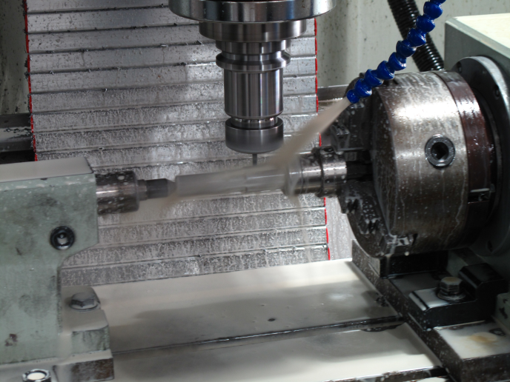
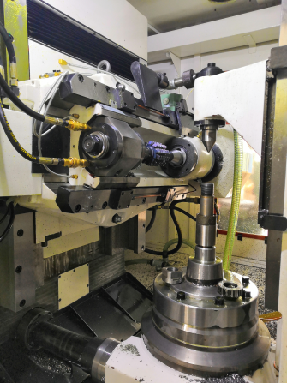
Production Process

Slide 5
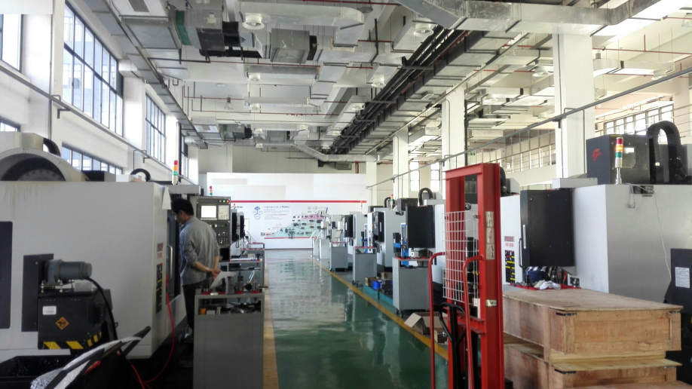
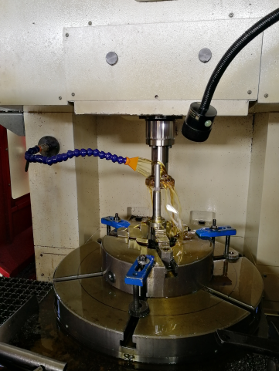
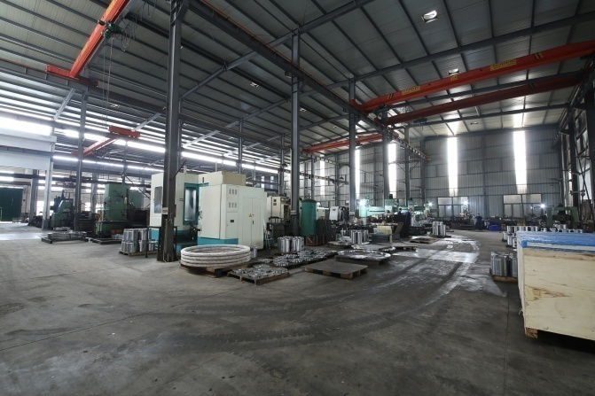
Production Process

Slide 6
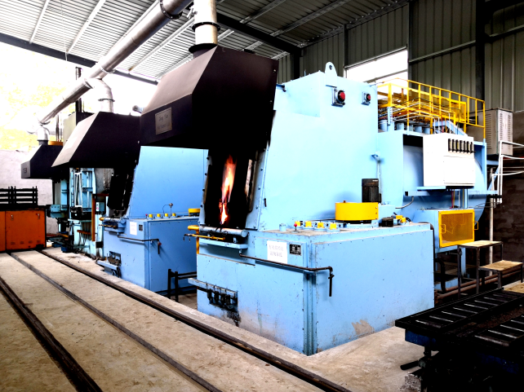
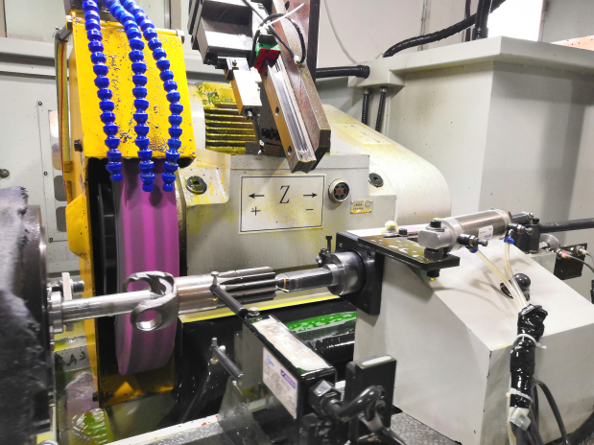
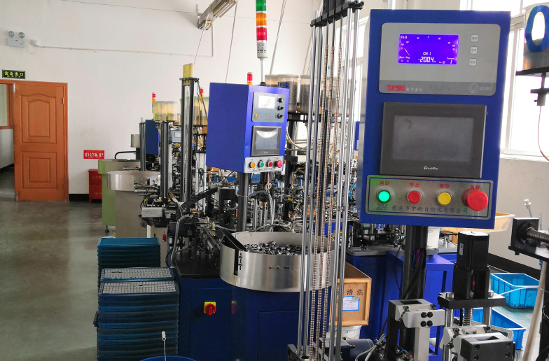
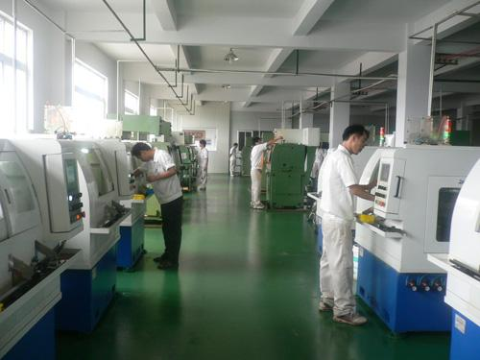
Production Process

Slide 7
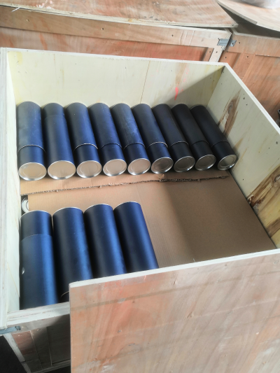
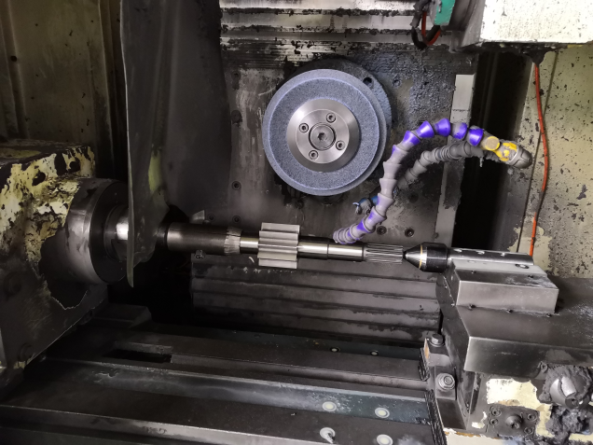
Production Process

Slide 8

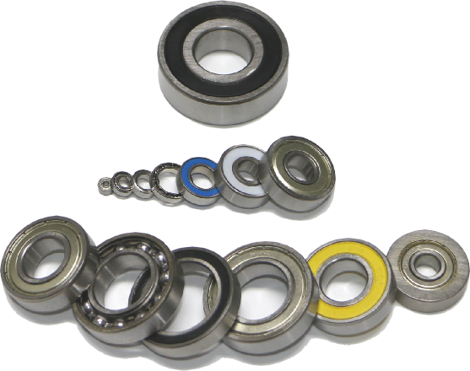
Here are Part of products we supplied:
Ball bearing
( ID3—500mm)
Single Row
Deep Groove Ball Bearing

Slide 9
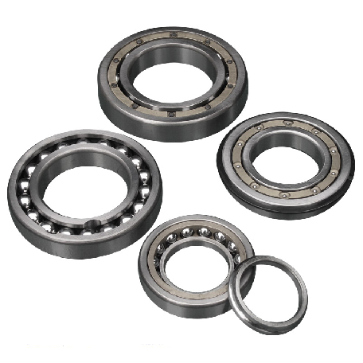
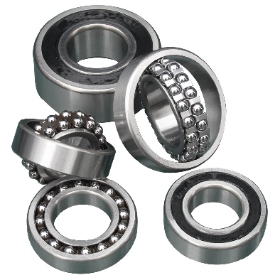
Slef-aliguing ball bearing
Angular contact ball bearing
Single Row
Three/four-point coutact ball bearing. Full balls,or cage made of plastic/brass/phenolic

Slide 10
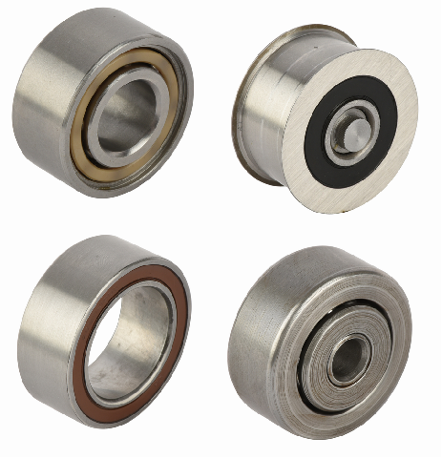
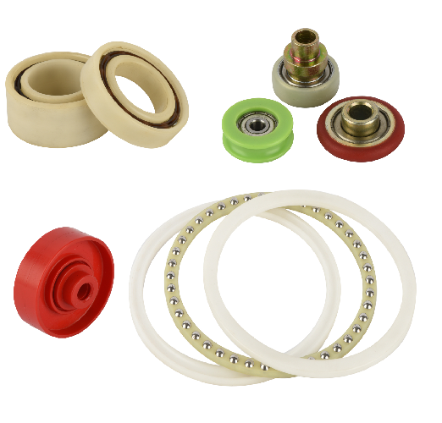
Double Row Ball Bearing
Plastic
Bearing
Works in special condition such as water , acid ,
Alkali liquid, steam enviroment .

Slide 11
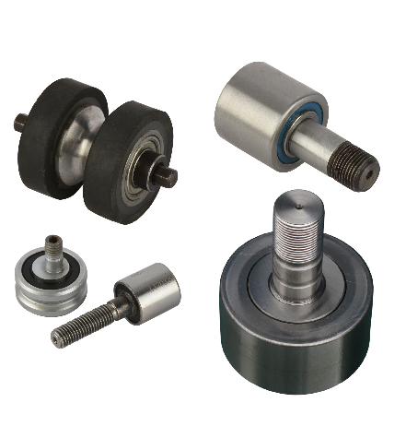
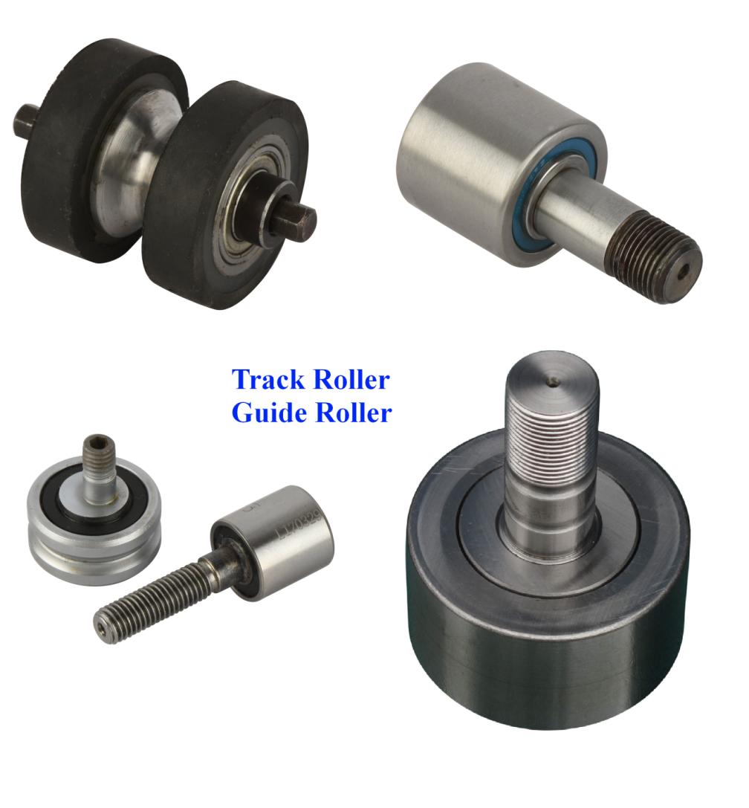
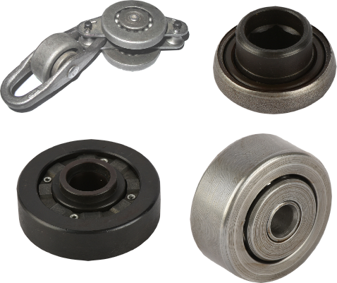
Trace Roller
Track Roller
Guide Roller

Slide 12
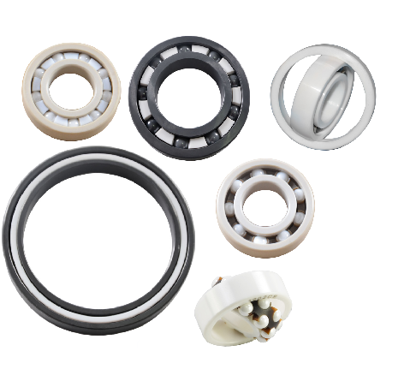
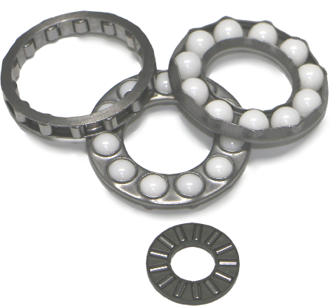
Ceramic Bearing
Engineered Roller Cage
AND

Slide 13
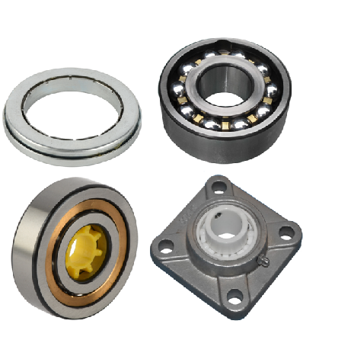
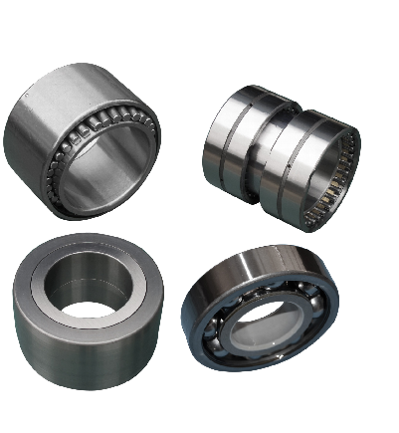
Engineered Bearing
AND

Slide 14
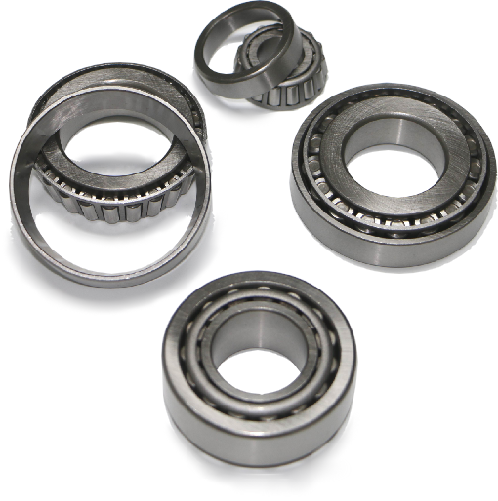
Tapered Roller Bearing
(ID15-500MM)

Slide 15
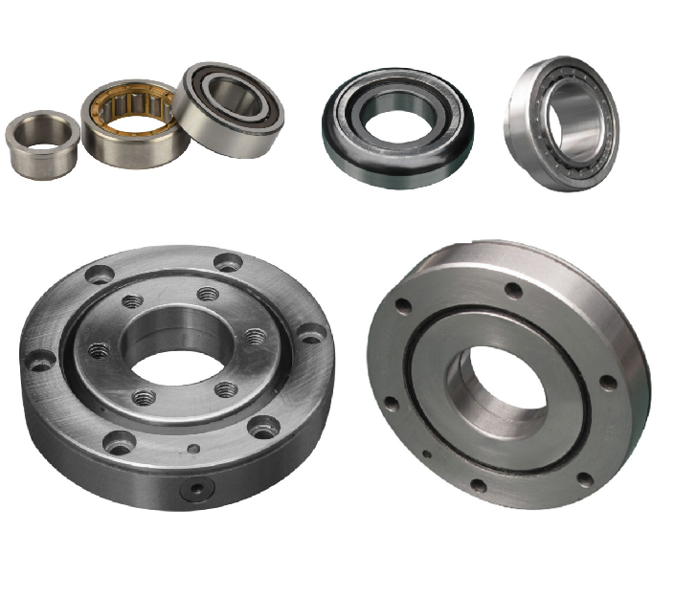
Cylindrical Roller Bearing
(ID15-500MM)
AND

Slide 16
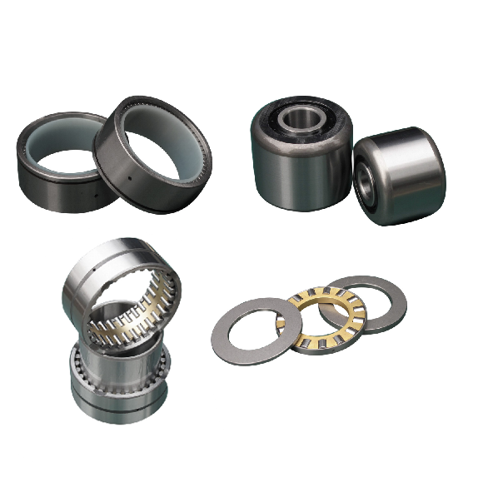
Cylindrical Roller Bearing
AND

Slide 17
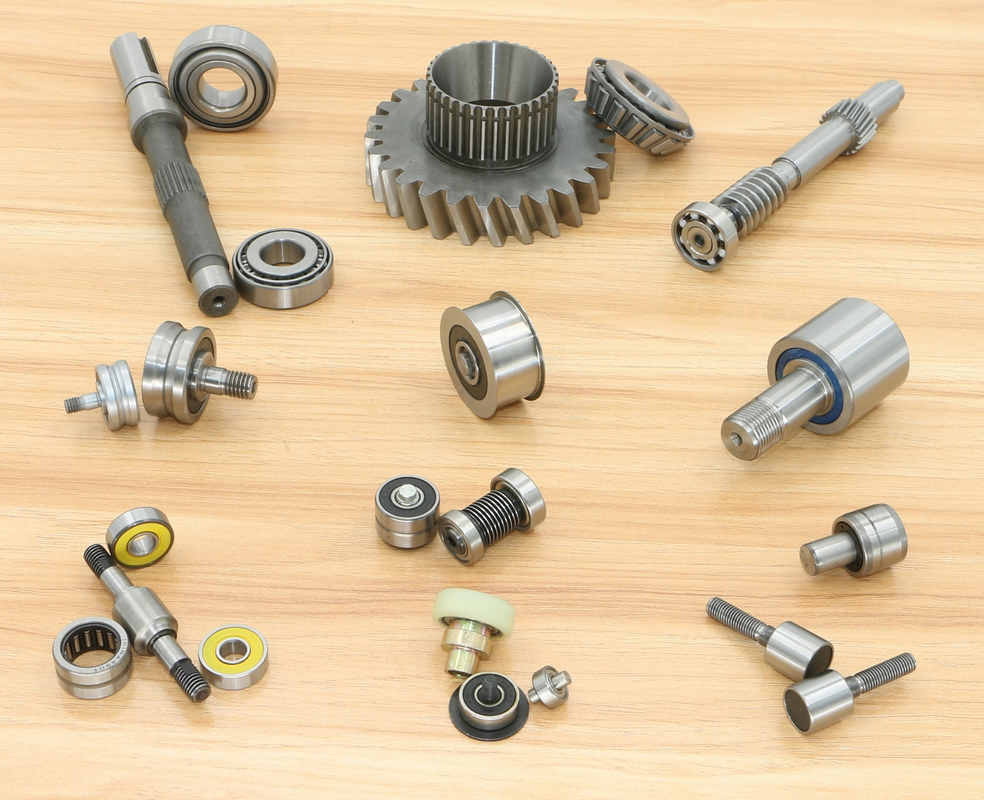
Engineering&
Supply
consolidated
Bearing&shaft&Gear

Slide 18
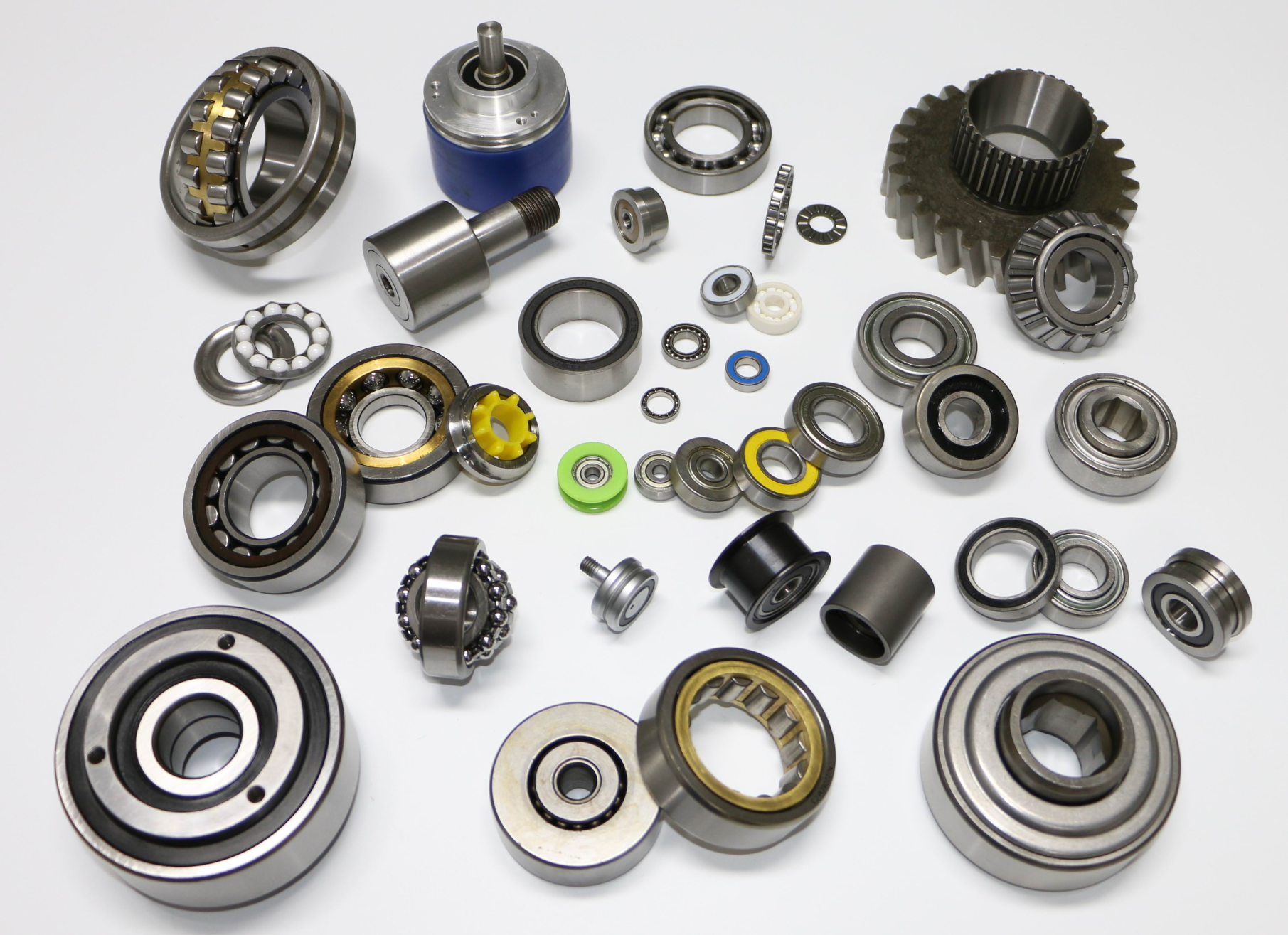
AND
AND
AND

Slide 19
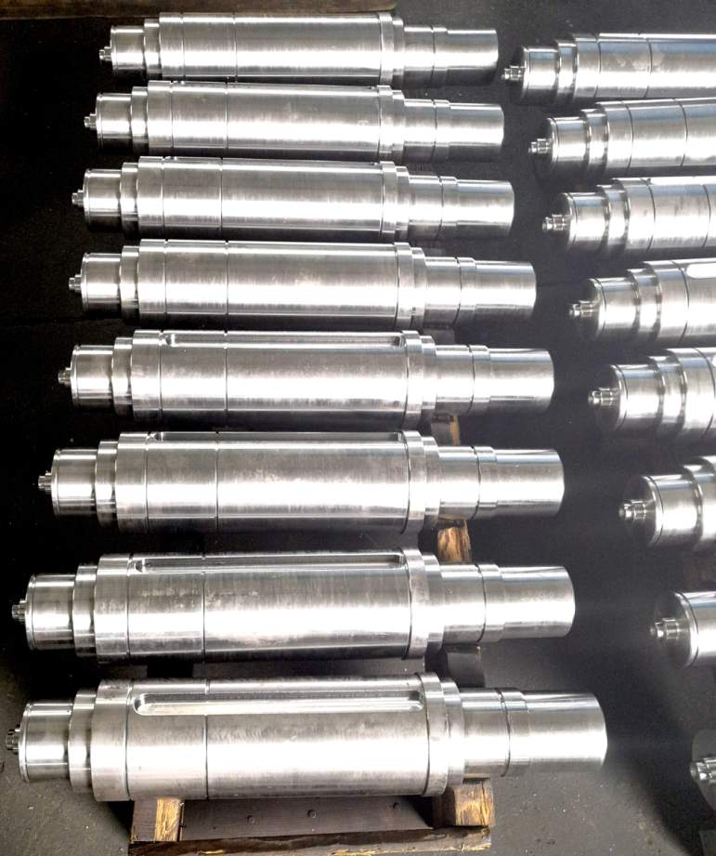
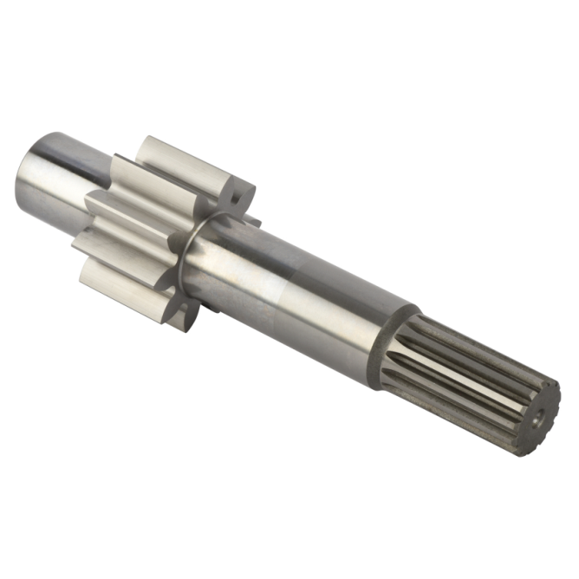
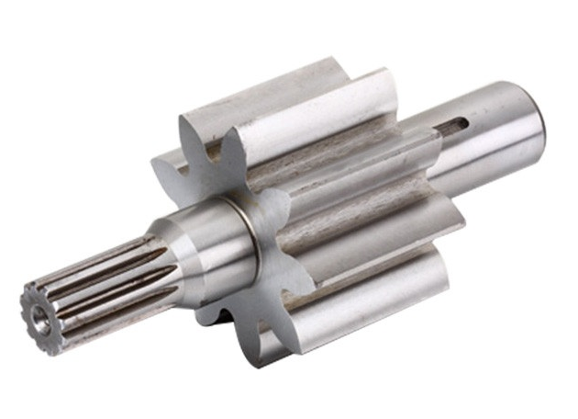
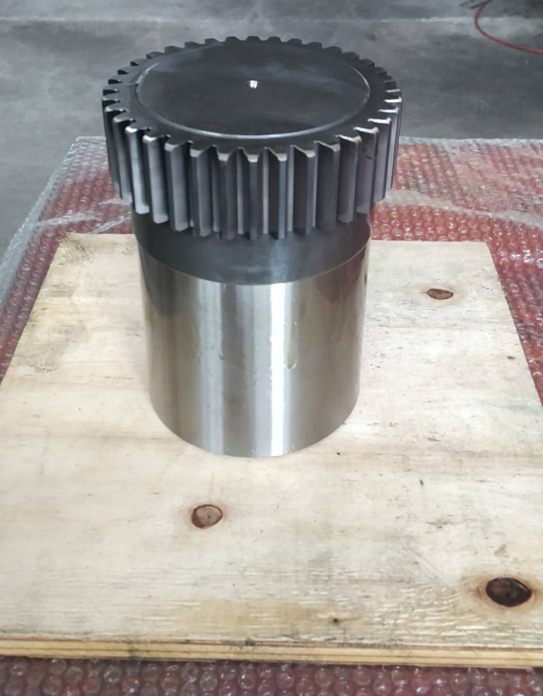
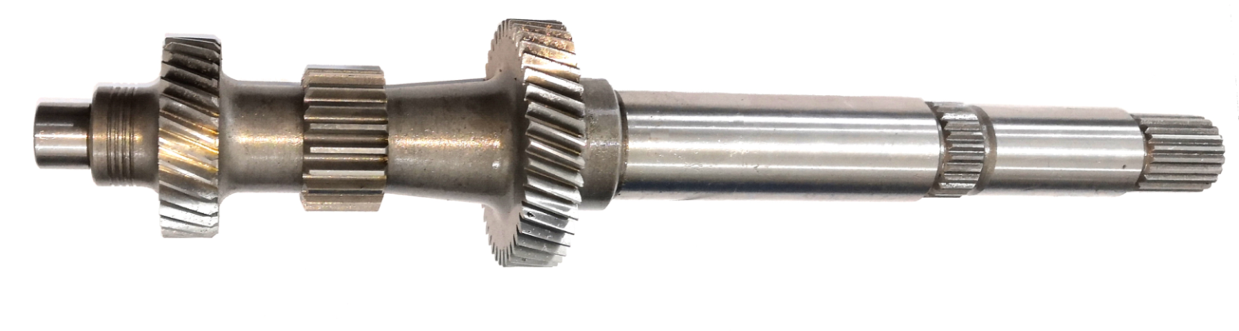
Gear
Shaft
AND

Slide 20
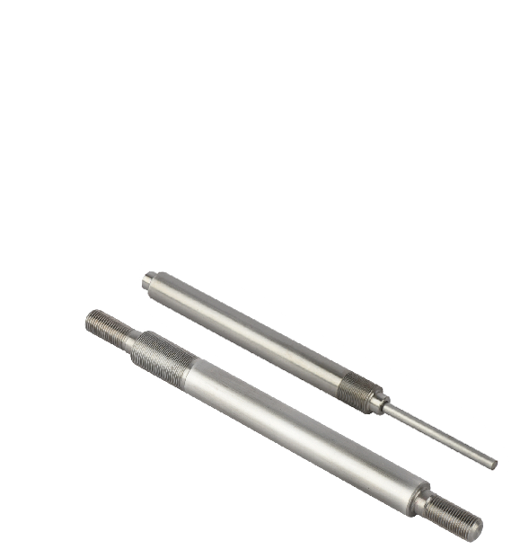
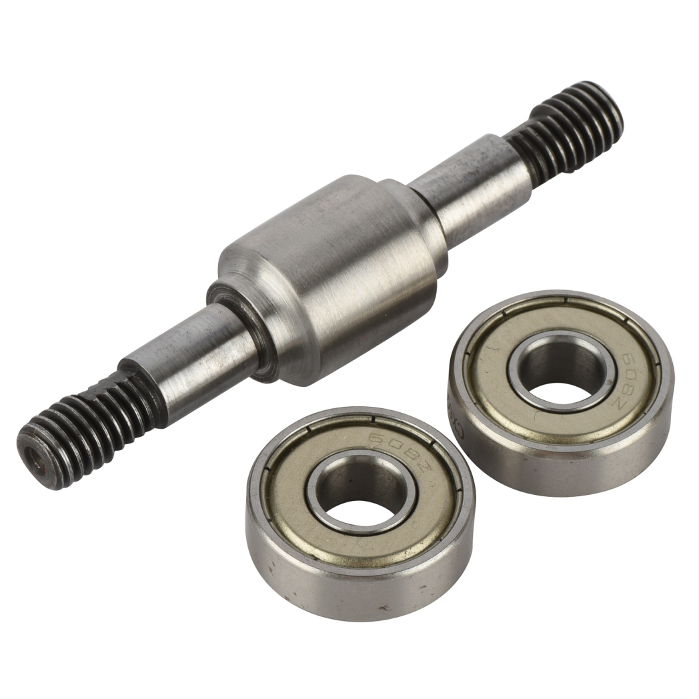
Axle

Slide 21
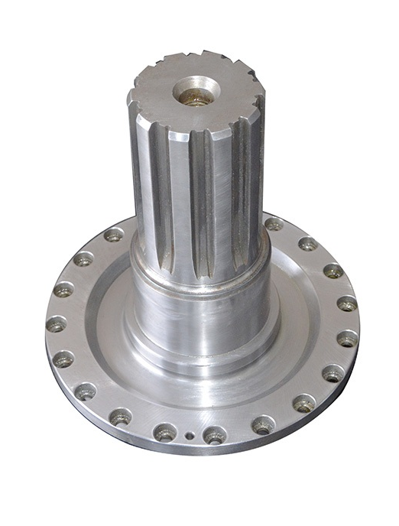
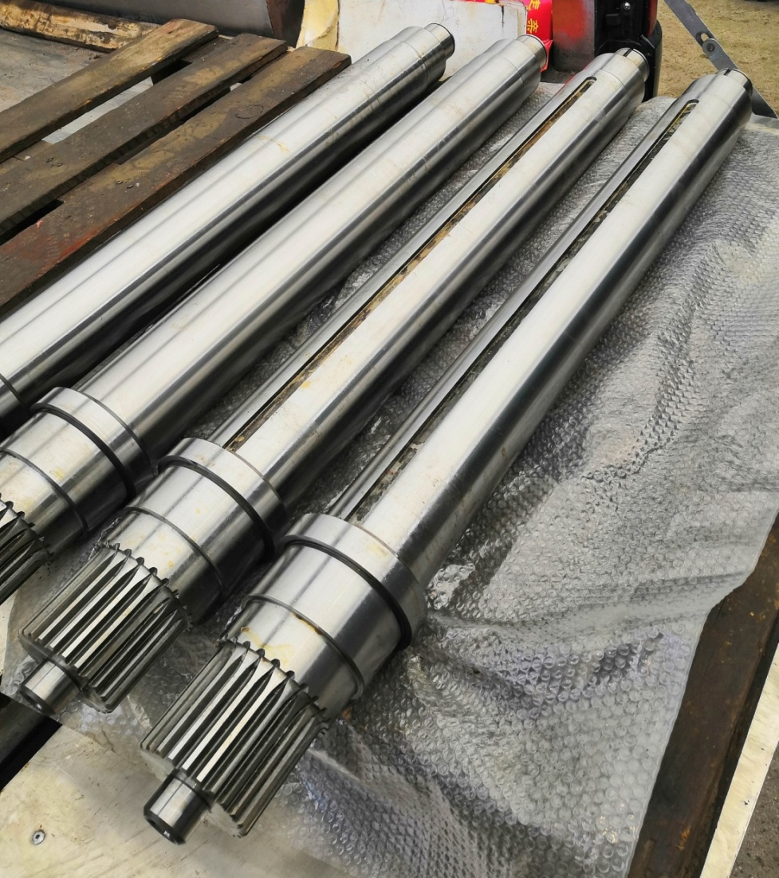
Spline Shaft

Slide 22
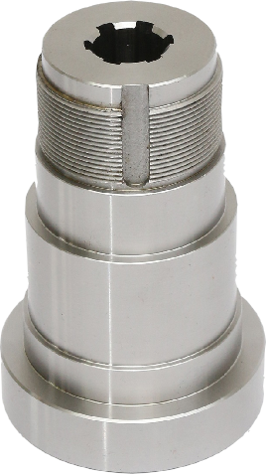
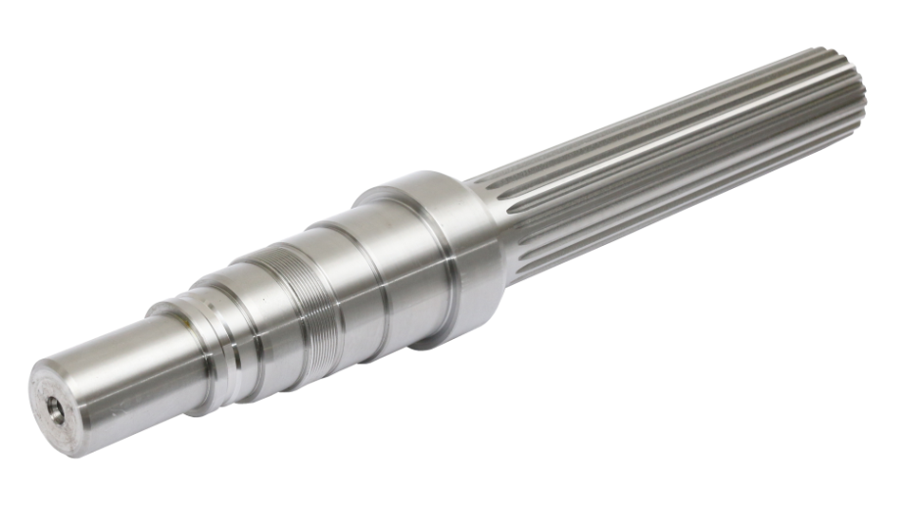
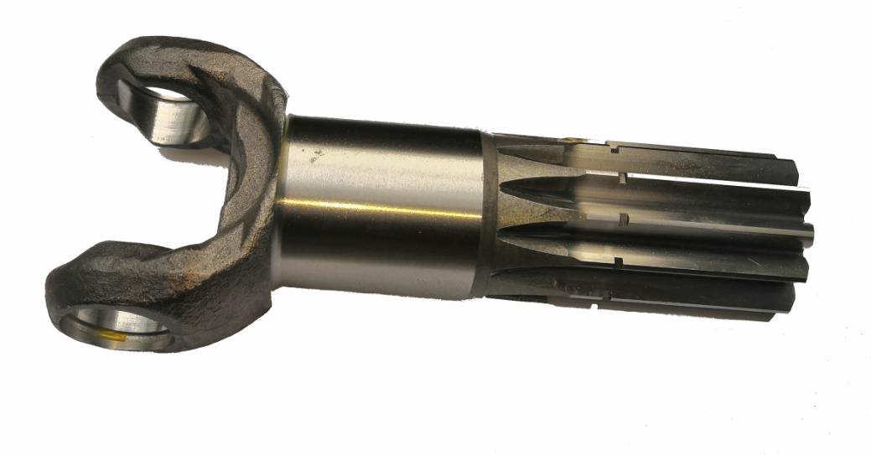
Spline Shaft

Slide 23
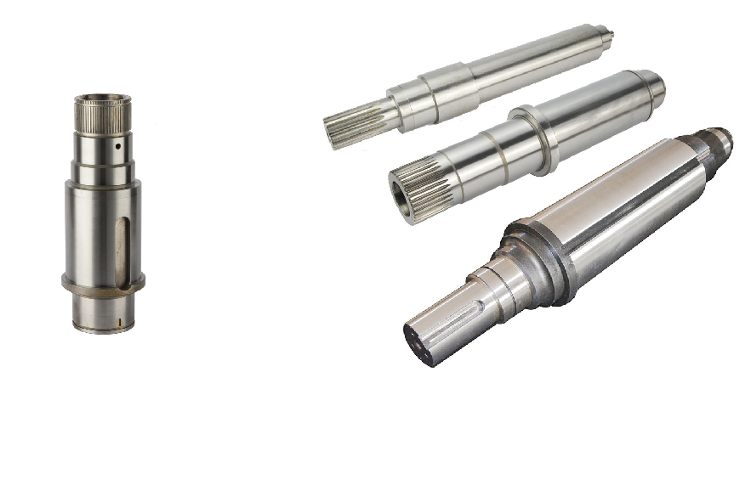
Electric
Motor
Shaft
AND

Slide 24
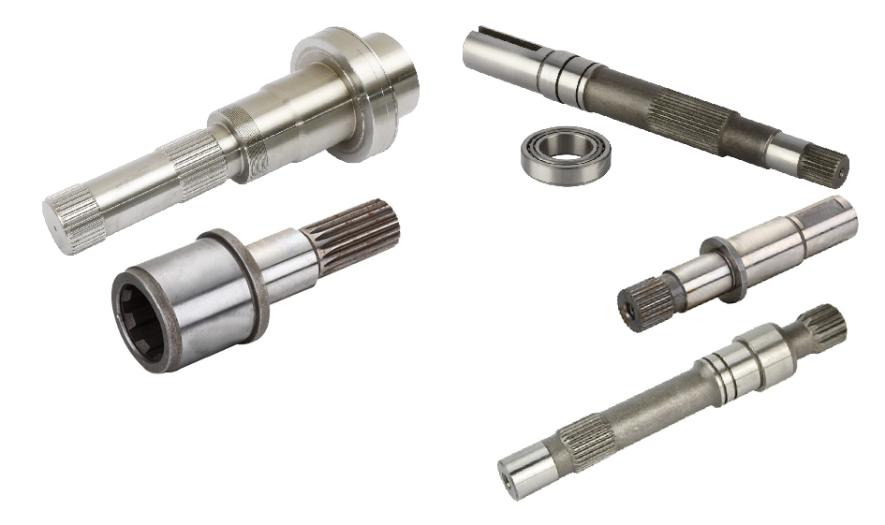
Drive Shaft
AND

Slide 25
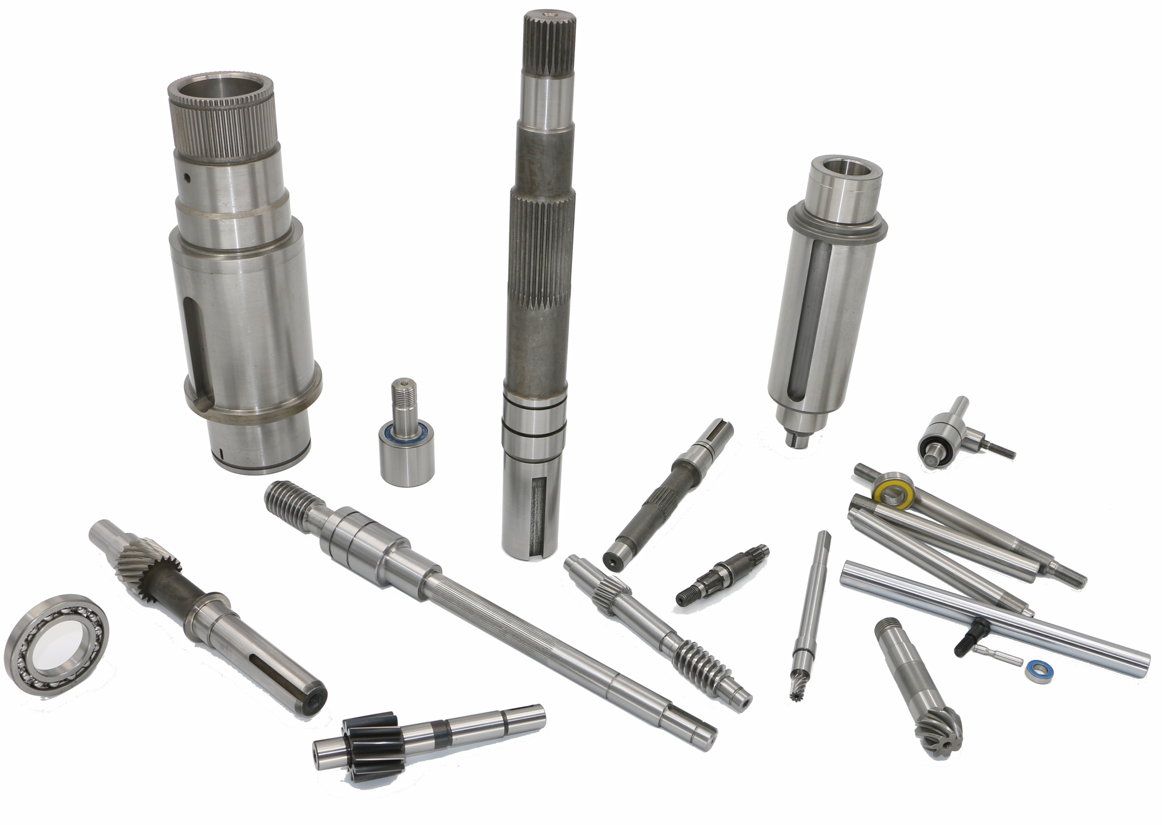
Shafts

Slide 26
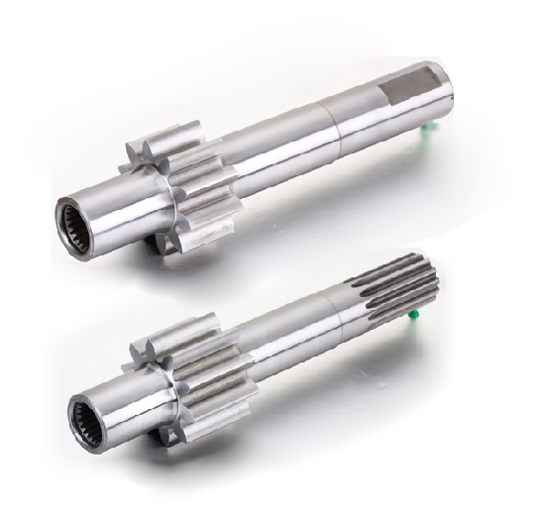
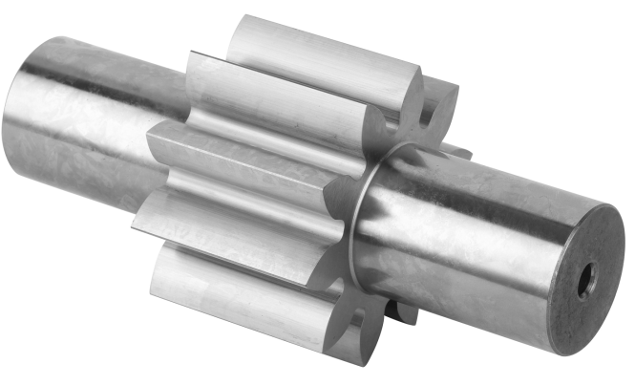
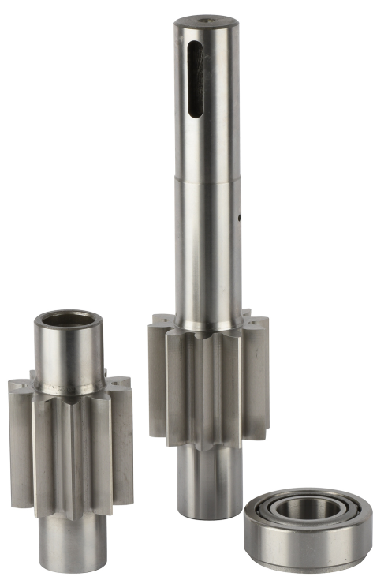
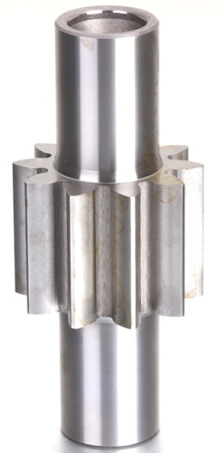
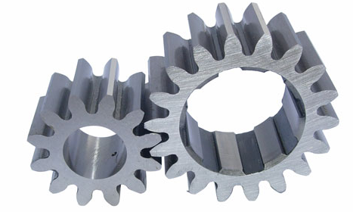
Hydraulic Pump Gear

Slide 27
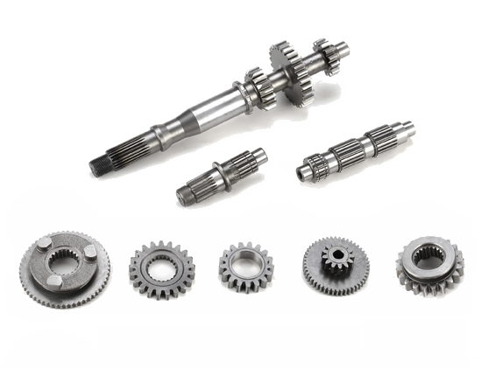
Gear

Slide 28

Gear
(Module 0.5-12 , AGMA-11)
AND

Slide 29


Gear

Slide 30


Gear
AND

Slide 31
WE ARE GOOD AT:
Our well-educated engineers cooperative work with the experts-who with many years of experience in the mechanical processing industry-in workshops,comprehensively consider the balance between product performance and processing capacity/processing costs, that is, to ensure product performance while controlling lower costs; we have the ability to participate in the discussion of optimal design of transmission parts when clients develop new products, to help speed up the development process;
Each of our manufacturers has specialized products and processes he is good at , which is the most cost-effective - based on this concept, we integrate and manage our supply chain, form a production-sales community. To make every high-quality product, manufacturers in the community cooperates with each other. We, AND, play an important role in the community. We participation makes the communication more smooth and the supply chain runs more efficient and stable. We organize and manage orders according to ISO9000 or IATF16949 quality system—most manufacturers have the certificates , AND is trying to get the certificates soon, strictly control the quality / improve the quality. We turn the customer's requirements, ideas and concepts into reality, make the products more competitive and help my client successful.
Three parties , manufacturers-we, AND-foreign clients in terms of engineering/quality control & improvement/cost control form complementary relationship during cooperating , we are win-win.
We have established firm cooperative relationship with clients all over the world in the past 20 years , built good reputation depends on our professional technical ability and perfect service.
We are unsung heroes, supporting machines running in every corner of the world.
Drop me an opportunity to become a trusted partner to you !

Slide 32
Contacts
Almost all the products listed above are customized for each customer.
If you need bearings, shafts and gears,please contact us：
Tel.: 0086-574-8714 9648 , 8712 1096
0086-137 7712 0064
Mail: Tech@and-china.com ,
info@and-china.com

